Slide 1
M. KUMARASAMY COLLEGE OF ENGINEERING DEPT OF CSE [ 2020- 2022 ] Batch 18CSP202L - MAIN PROJECT FINAL PRESENTATION
Date : 06.08.22
Batch Number : CSE

Slide 2
NORMALIZATION OF DUPLICATE RECORDS FROM MULTIPLE SOURCES
Name of the Candidates : DINESHWARAN
HARIHARAN G
MOHAMED NOWFAL S
Register Number : 20BCS4022
20BCS4303
20BCS4305
Name of the Supervisor : Mrs. KARTHIKA I AP/CSE
with Designation

Slide 3
Objectives of the Project
In proposed System, we try to implement normalization of duplicate records which are present in the DBMS, Here we try to apply record level normalization and try to remove all the duplicate records which are present in the database.
In general several data owners try to upload different documents and if any document is already present in the database, this record level normalization will try to identify such duplicate cells and then identify the necessity of normalization.
The main scope for designing this current application is to over come the problem which is faced in current networks.

Slide 4
Objectives of the Project Contd..
It must display a normalized record to users. Otherwise, it is unclear what can be presented to users present the entire group of matching records or simply present some random record from the group, to just name a couple of ad-hoc approaches.
Either of these choices can lead to a frustrating experience for a user, because in the user needs to sort/browse through a potentially large number of duplicate records
we run the risk of presenting a record with missing or incorrect pieces of data.

Slide 5
Introduction to Project
The usefulness of Web data increases exponentially (e.g., building knowledge bases, Web-scale data analytics) when it is linked across numerous sources.
Structured data on the Web resides in Web databases and Web tables. Web data integration is an important component of many applications collecting data from Web databases, such as Web data warehousing
Integration systems at Web scale need to automatically match records from different sources that refer to the same real-world entity find the true matching records among them and turn this set of records into a standard record for the consumption of users or other applications.

Slide 6
Introduction to Project Contd..
There is a large body of work on the record matching problem and the truth discovery problem.
The record matching problem is also referred to as duplicate record detection, record linkage, object identification, entity resolution, or de-duplication and the truth discovery problem is also called as truth finding or fact finding - a key problem in data fusion.
This work assumes that the tasks of record matching and truth discovery have been performed and that the groups of true matching records have thus been identified.

Slide 7
Existing System Architecture-Findings
The most existing methods of data normalization and detecting duplicate records is done based on the quantitative features of the individual record.
In some cases these features can be easily identified and on other side some data cannot be normalized easily.
In the existing system there is no accuracy for normalizing the records and finding the duplicate records and tuples.
In the existing work, the system uses only Field-level normalization. There is no Integration system at Web scale which needs to automatically match records from different sources that refer to the same real-world entity

Slide 8
Proposed System Architecture
In general it is very problematic for data consolidation to achieve the normalized data. We refer to this task as record normalization.
Such a record representation, coined normalized record, is important for both front-end and back-end applications. In this proposed application, we mainly try to normalize the records and try to find out the duplicate record attributes and then try to normalize that duplicate files while are present in database.
We conducted extensive empirical studies with all the proposed methods.

Slide 9
Modules in Project
View All End Users and Authorize
View All Uploaded Publications,
View All Duplicated Publication Records,
View All Normalized Publication Record
View All Normalized Publication Record
View All Bookmark Search History

Slide 10
Literature Survey
Literature survey is the most important step in software development process. Before developing the tool, it is necessary to determine the time factor, economy and company strength.
Once these things are satisfied, ten next steps are to determine which operating system and language used for developing the tool.
Once the programmers start building the tool, the programmers need lot of external support.

Slide 11
User Module
In this module, there are n numbers of users are present. User should register before doing any operations. Once user registers, their details will be stored to the database.
After registration successful, he has to login by using authorized user name and password. Once Login is successful user will do some operations like
1.Search Publication
2. Search Bookmark,
3. View Bookmark Search History, and View Publication Search History.

Slide 12
Software Requirements
HARDWARE REQUIREMENTS:
System : Pentium Dual Core.
Hard Disk : 120 GB.
Monitor : 15’’ LED
Input Devices : Keyboard, Mouse
Ram : 1 GB
SOFTWARE REQUIREMENTS:
Operating system : Windows 7.
Coding Language : JAVA.
Tool Netbeans 7.2.1
Database : MYSQL

Slide 13
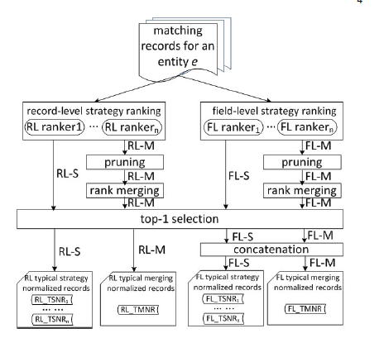
System Architecture

Slide 14
Conclusion
In this paper, the problem of record normalization is studied over a set of matching records that refer to the same realworld entity.
Three levels of normalization granularities (record-level, field-level and value component level) and two forms of normalization (typical normalization and complete normalization) are presented in this.
The complete normalization focused on field values and proposed algorithms for acronym expansion and value component mining to produce much improved normalized field values

Slide 15
References
[1] E. K. Rezig, E. C. Dragut, M. Ouzzani, A. K. Elmagarmid, and W. G. Aref, “ORLF: A flexible framework for online record linkage and fusion,” in ICDE, 2016, pp. 1378–1381.
[2] E. K. Rezig, E. C. Dragut, M. Ouzzani, and A. K. Elmagarmid, “Query-time record linkage and fusion over web databases,” in ICDE, 2015, pp. 42–53.
[3] A. Gruenheid, X. L. Dong, and D. Srivastava, “Incremental record linkage,” PVLDB, vol. 7, no. 9, pp. 697 708, May 2014.
[4] P. Christen, “A survey of indexing techniques for scalable record linkage and deduplication,” TKDE, vol. 24, no. 9, 2012

Slide 16
Any Queries
Thank you

